Slide 1
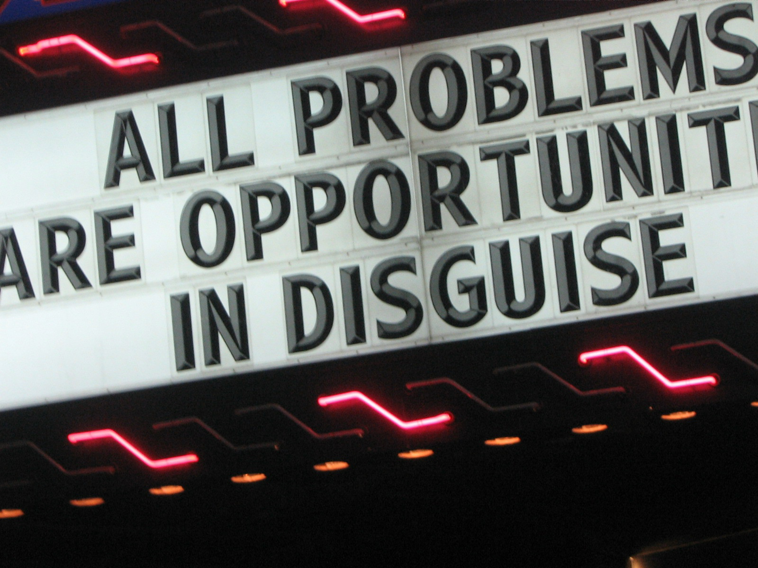
PEOPLE
By: Alice, Andy, Ben, Brian, & Ray

Slide 2

Microsoft
… was built by people working as a team

Slide 3


intros & our game…
Meet Microsoft’s
Shawn Kemp
First Best Practice
Goal Setting
Second Best Practice
Team Task Roles
LEGEND (wait for it) DARY
Suggestions
…telephone results

Slide 4

Meet Shawn
Here he is!
… and he’s checking out Microsoft’s next initiative

Slide 5
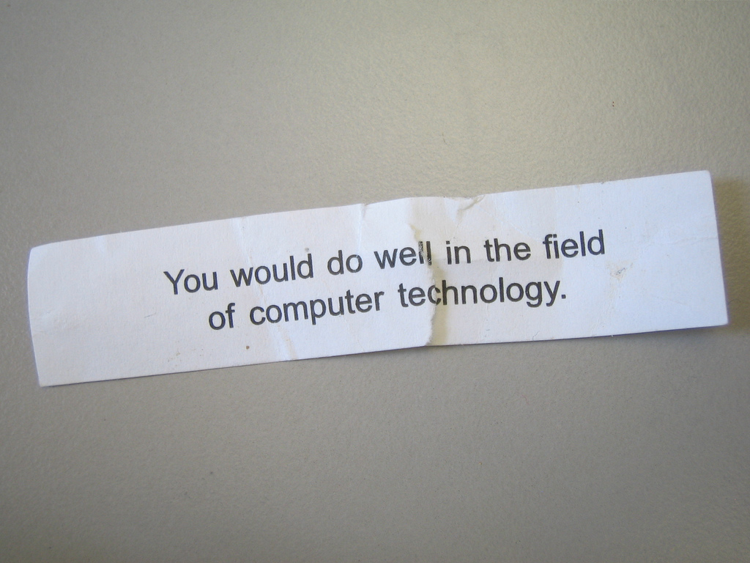
Shawn strives to be creative and innovative
… and facilitated these ideals in his teammates

Slide 6
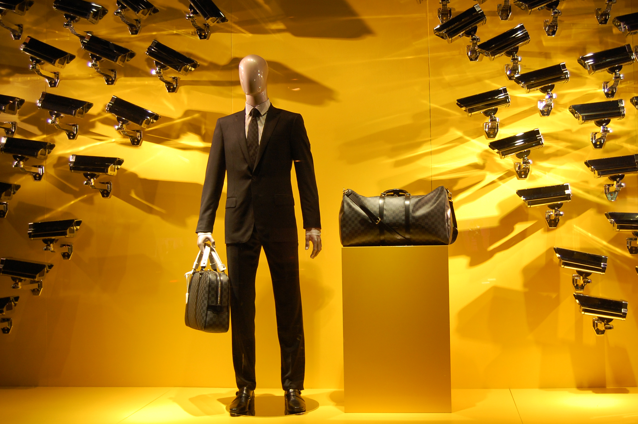
Shawn’s worst boss ruled by fear
… it worked, but it burned people out fast

Slide 7
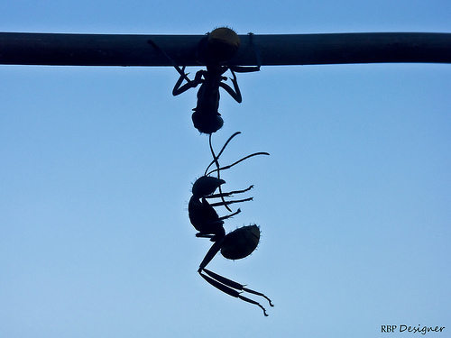
If I make the team’s goal clear and I show my teammates how they are working together, then we will achieve higher performance from process gain.
First Best Practice

Slide 8

Shawn built goal timelines for his teammates
… and accounted for individual strengths and ability

Slide 9

Shawn embedded his teammates with customers
… so they understood their responsibilities

Slide 10
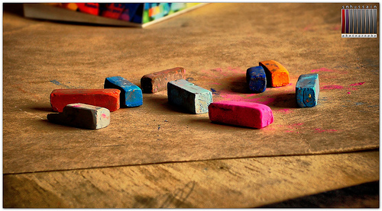
If I manage my team using distinct team task roles, then we will achieve higher performance by improving task-work processes.
Second Best Practice

Slide 11

Shawn acted as the team’s procedural technician,
… coordinator, and standards setter

Slide 12

Shawn promoted creativity and decision making
… by routinely sharing all information with his team

Slide 13

Shawn is an avoider because of his management style
… needs to confront friends/teammates a.s.a.p.
Suggestions

Slide 14

Shawn built high performing teams by
creating clear goals for each teammate
&
managed his team via distinct team task roles

Slide 15

Food for thought
people are opportunities; be creative and innovate

Slide 16
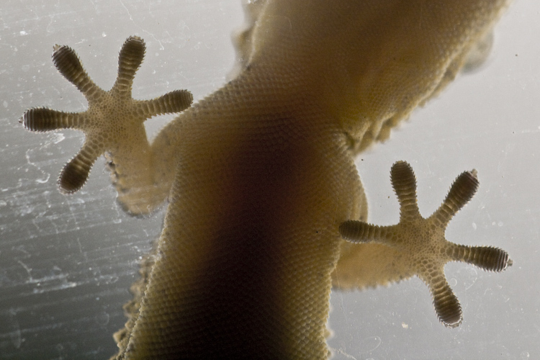
We hope it sticks

